Slide 1


Slide 2
ÖN ARAŞTIRMA
Yararlı olabilecek metodların araştırılması
Uygun datasetinin bulunması
ÖZELLİKLERİ BELİRLEME
DATASETİ DİZAYNI
Bir oteli tanımlarken kullanılabilecek özelliklerin
belirlenmesi
VADER yardımıyla yorumların olumlu – olumsuz şeklinde
ayrılması, her yoruma puan atanması
SKORLANDIRMA
Elde ettiğimiz sonuçlar neticesinde kategori kategori ortalama puanların belirlenmesi
SONUÇ
Sonuçların grafikler yardımıyla ilgili kişiye sunulması
5

Slide 3

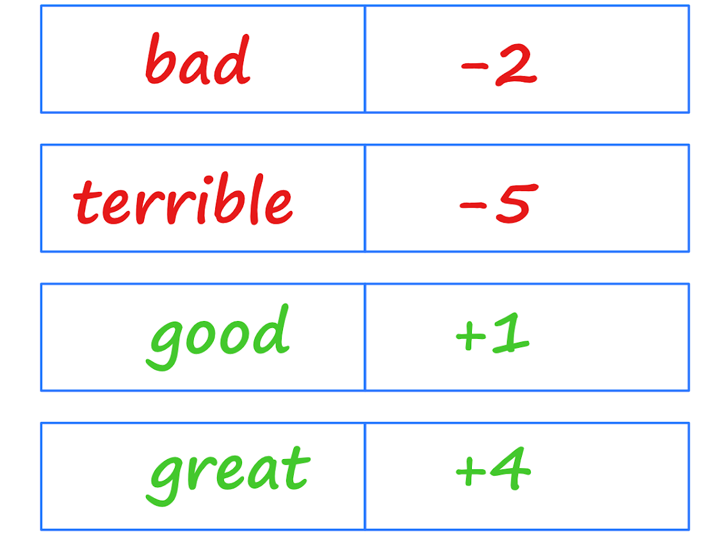
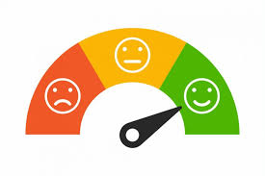

What is VADER?
Lexicon-based sentiment analysis tool
uses a list of lexical words which are generally labeled according to their semantic orientation as either
positive or negative
not only tells about the Positivity and Negativity score but also tells us about how positive or negative a sentiment is
it doesn’t need any training data.

Slide 4
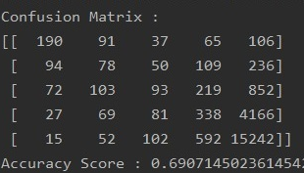
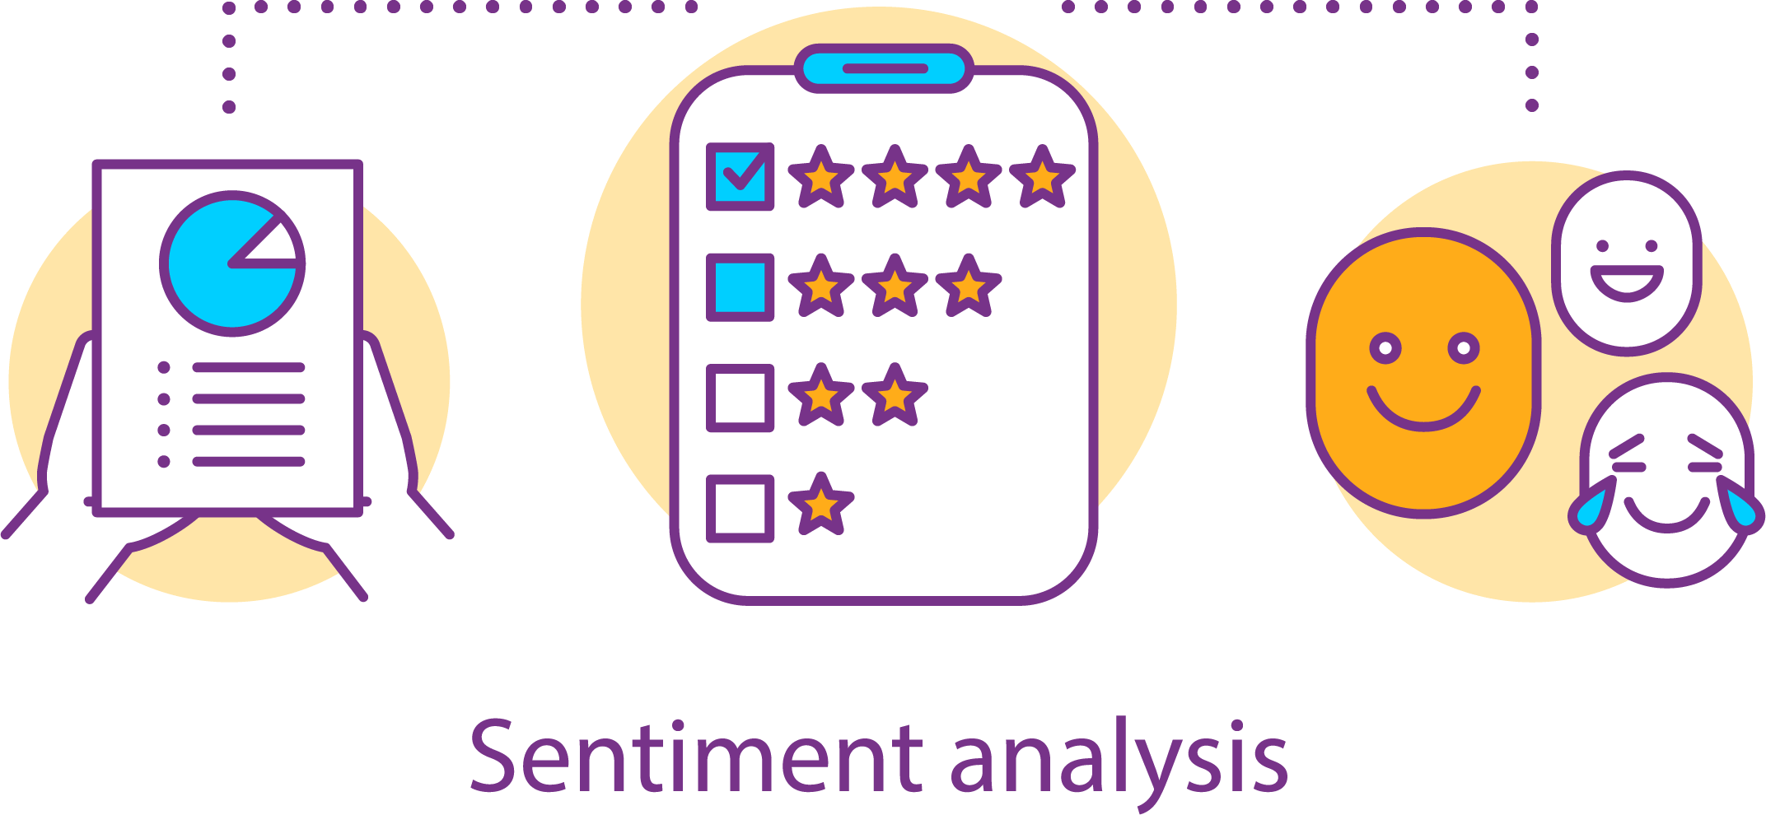
VADER Results
%69
Confusion Matrix
3 main groups
%90
• Stars rated as 1 - 2 equal to negative
• Stars rated as 3 equal to notr
• Stars rated as 4 – 5 equal to positive
Detailed results at page 17

Slide 5




‘your algorithm is as strong as your data’
negative
positive
Hotel reviews
28 thousand
Mixed up

Slide 6
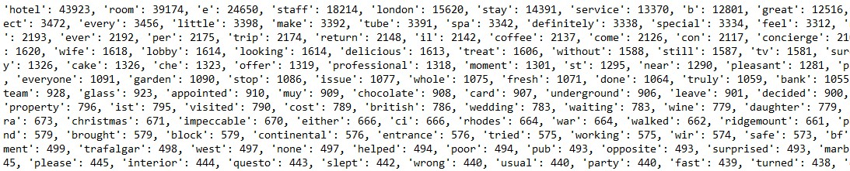
Determination of Hotel Attributes
As first step, WordCount was used to find most used words
Which ones are related associated with hotel services?
restaurant
bathroom
view
staff
breakfast
room
bed
hotel
food
service
location

Slide 7
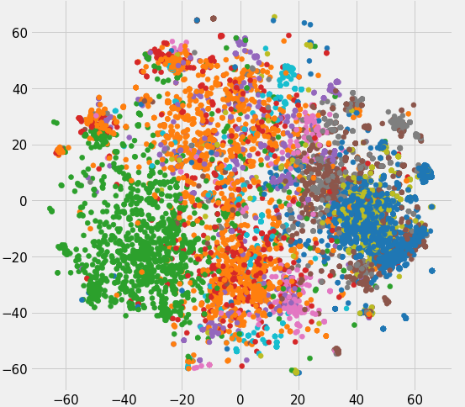
Usage of Word2Vec & FastText
Word2vec is used to produce word embeddings. It takes as its input a large corpus of text and produces a vector space. Word vectors are positioned in the vector space such that words that share common contexts in the corpus are located close to one another in the space
personnel
team
staff
employee
receptionist
15% ↑
Fasttext is with N-gram version of Word2Vec. Used for misspelling detection during the project.
veiws
wiev
view
viev
veiw

Slide 8

personnel
professional
employee
position
proximity
located
situate
staff
location
staf
team
views
viewed
facing
viewpoint
spot
center
bedroom
rooom
roomy
view
staffer
doorstaff
everyone
attraction
locate
room
partial
glimpse
veiw
vista
overlook
veiws
facing
inroom
roooms
bathrooom
bathrooms
bathrom
rainfall
buffet
continental
breakfats
brekfast
bathroom
breakfast
tub
bathtub
bath
washroom
bfast
cereal
eggs
cooked
restaurants
resturant
boulud
beds
bedded
bedsheets
mattress
massimo
resturants
restaurant
bed
boloud
pierino
eatery
restuarant
pillow
bedding
duvet
chair
cushion
hotels
property
accommodation
seafood
meal
dish
risotto
serviced
sevice
seervice
servicing
hotel
food
service
menu
sole
establishment
accomodation
place
cuisine
burger
risotto
massimo
roomservice
presentation
approachable

Slide 9

Summary

Slide 10


Slide 11





Program Path

